Slide 1
Getting Started with Git
Tools for Efficient Scientific Production Francisco Bischoff

Slide 2
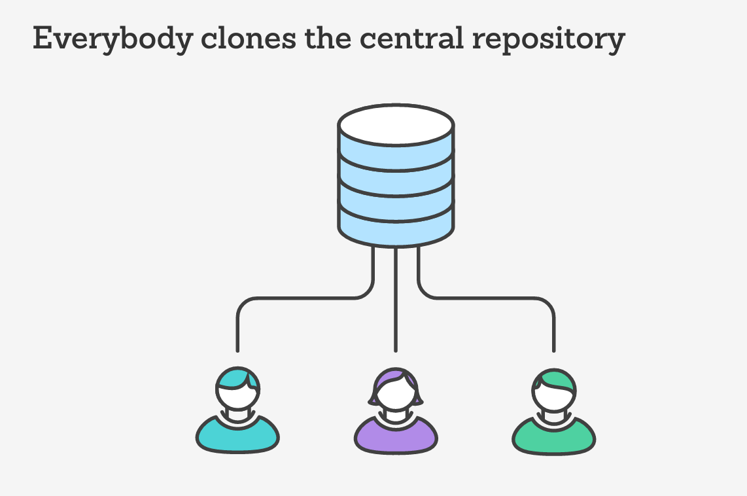
What is Git?
Git is a distributed version control system that allows multiple people to collaborate on a project.

Slide 3
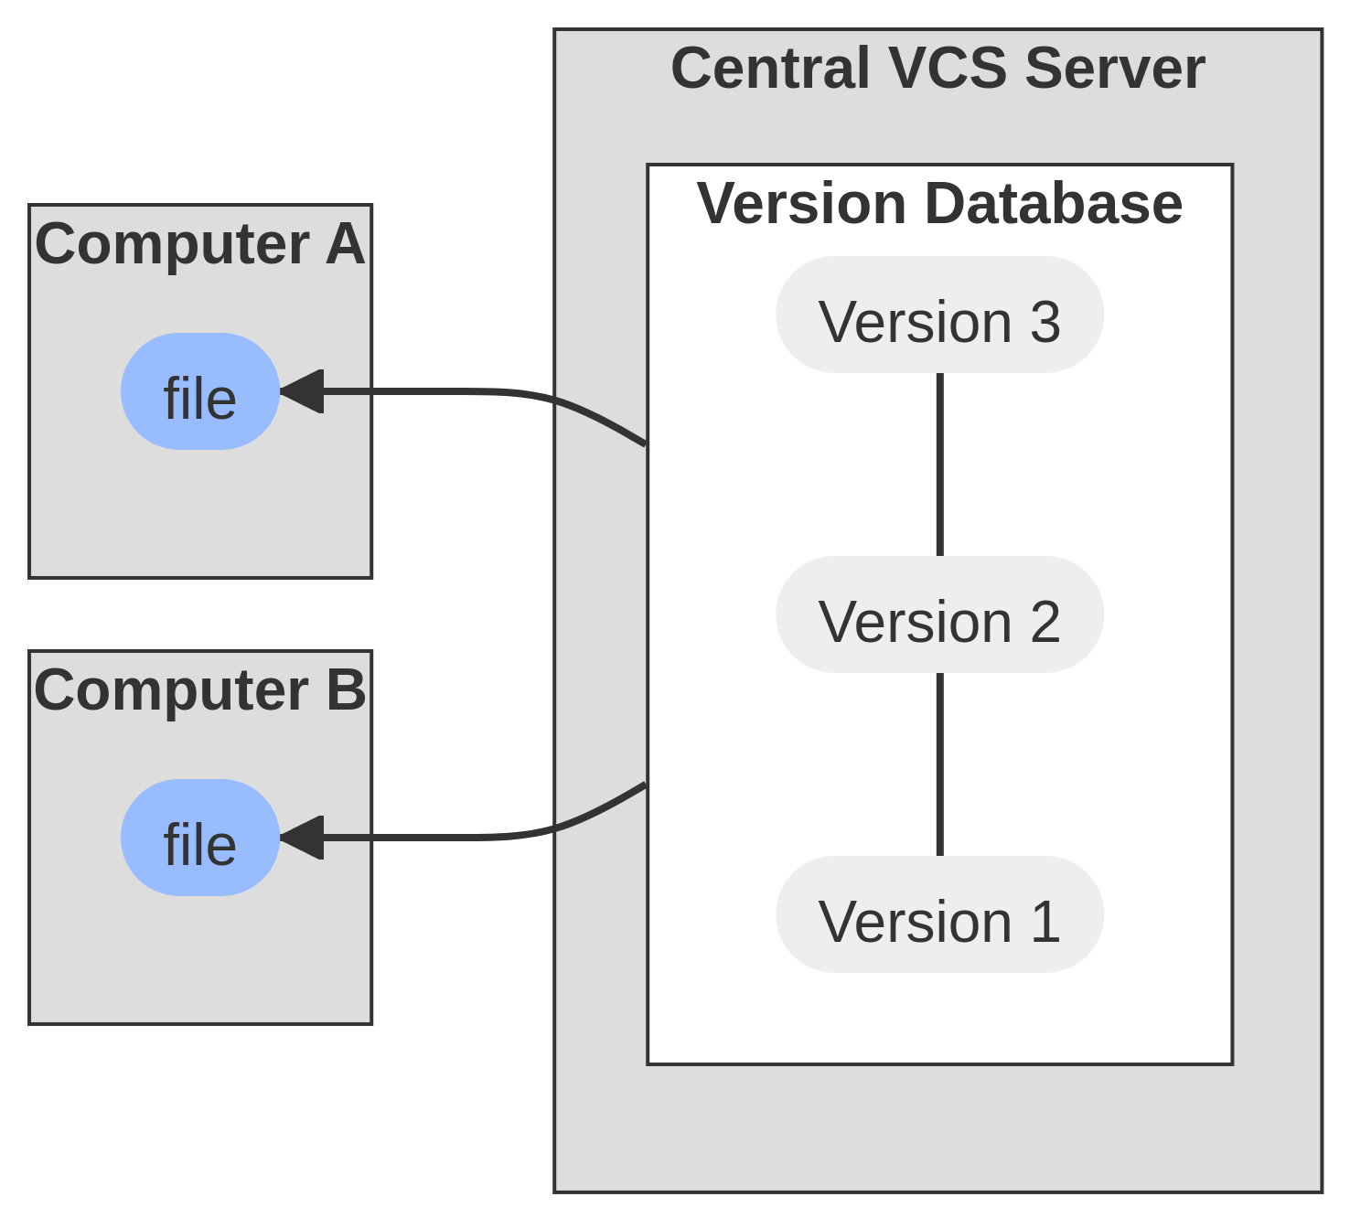
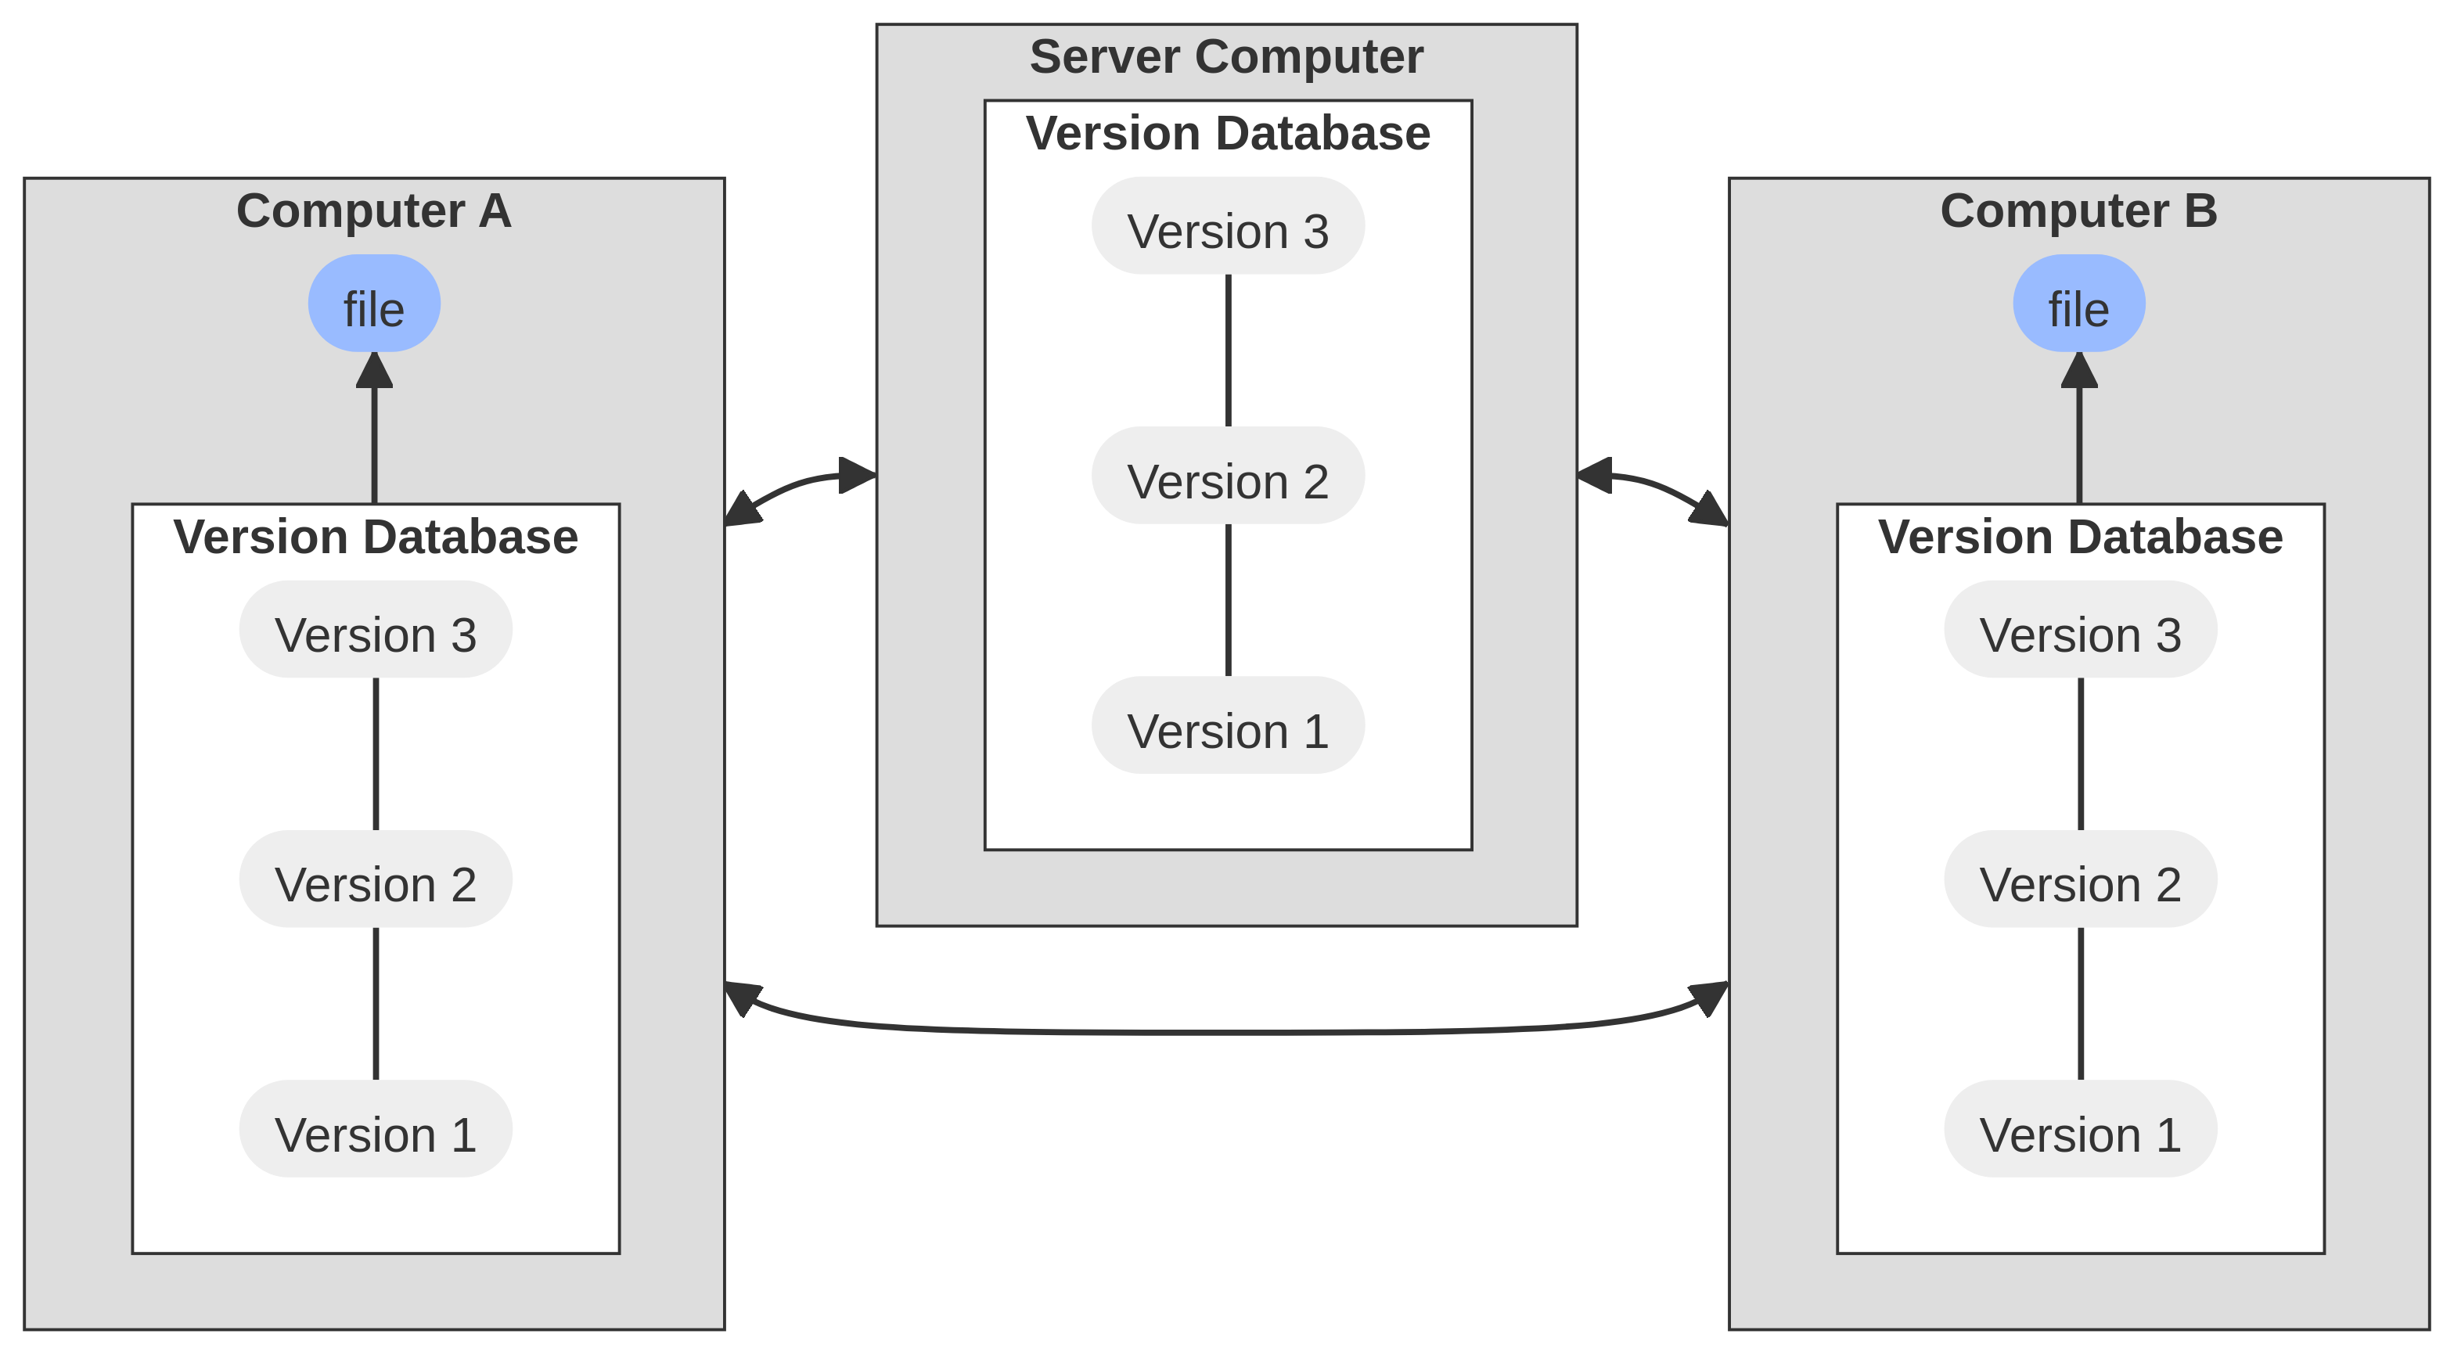
What is Git?
CVS (1986), SVN (2000)
Git (2005), Mercurial (2005)
Notes:
Intro: 5min

Slide 4
Why use Git?
Git helps track changes to files and allows you to easily revert to previous versions.
It enables collaboration and allows multiple people to work on the same project simultaneously.
Git provides a history of changes, making it easier to understand the evolution of a project.
Notes:
Intro: 5min

Slide 5
Git Basics
Repository: A Git repository is a collection of files and their complete history of changes.
Commit: A commit is a snapshot of the repository at a specific point in time. It represents a set of changes made to the files.
Branch: A branch is a separate line of development. It allows you to work on different features or bug fixes without affecting the main codebase.
Merge: Merging combines changes from different branches into a single branch.
Notes:
Setup account: 10min

Slide 6
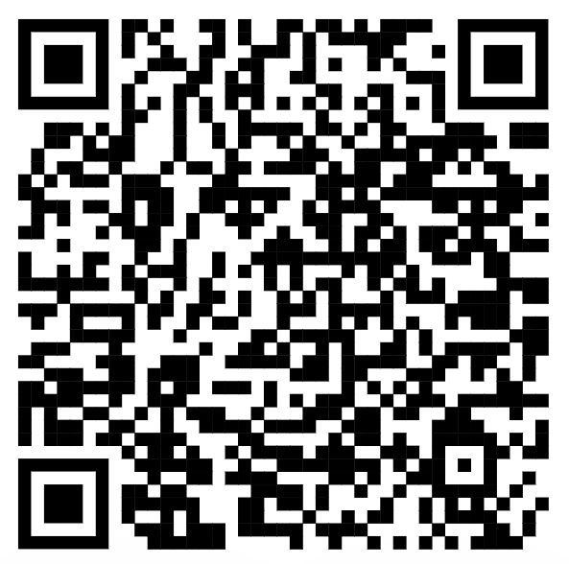
Git Workflow
Create a new repository or clone an existing one.
Make changes to files in the repository.
Stage the changes.
Commit the changes.
Push the changes to a remote repository.
Cheat sheet
Notes:
Hands-on: 15min

Slide 7
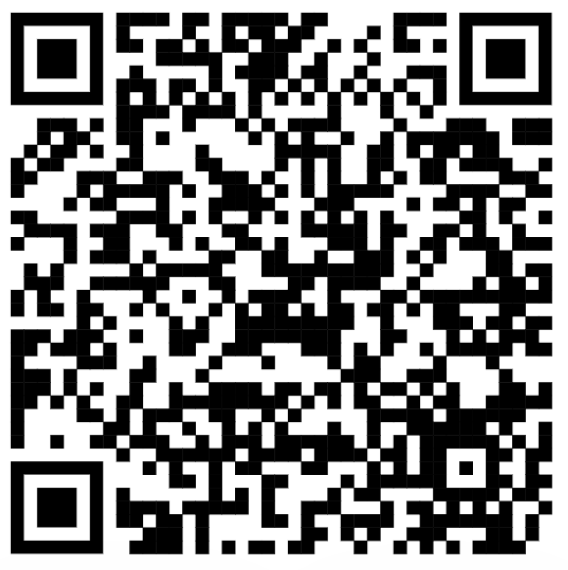
Conclusion
Git is a powerful tool for version control and collaboration. Understanding its basics is essential for any software developer.
More information on Git

